Slide 1


CAPSTONE PROJECT
TechCrush Capstone Project
Title: Building a Secure Small Network
Cybersecurity Capstone Project | Cisco Packet Tracer, Nmap/Zenmap, and Wireshark
Prepared by: Igbo Chioma C.
Course: Cybersecurity Capstone Project
Date: May 2026
Disclaimer: This training material belongs to techcrush and shouldn’t be shared

Slide 2
CAPSTONE PROJECT
Project Objective and Scope
Objective
Design a basic small office network layout.
Apply practical security controls to protect the network.
Test the network using scanning and traffic analysis tools.
Explain how the design helps defend against common threats
Network diagram created in Cisco Packet Tracer.
Basic security controls: passwords, segmentation, firewall rules, port scanning/hardening.
Threat simulation: port scanning attempt and response.
Screenshots and logs used as evidence.
Disclaimer: This training material belongs to techcrush and shouldn’t be shared

Slide 3
CAPSTONE PROJECT
Tools Used
Tool | Purpose
Cisco Packet Tracer | Network topology design and simulation
Router/ASA/Switch | Network control points and security boundary
Nmap/Zenmap | Port scanning and service discovery
Wireshark | Packet capture and traffic analysis
Packet Tracer Command Prompt | Ping/connectivity testing
Disclaimer: This training material belongs to techcrush and shouldn’t be shared

Slide 4
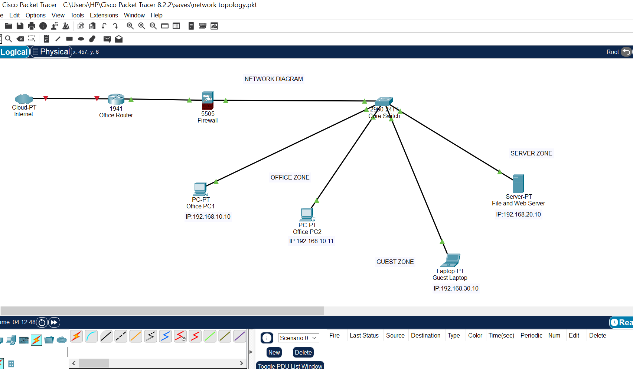
CAPSTONE PROJECT
Network Topology Overview
Internet represented by Cloud-PT.
Office Router connects the office to the internet side.
ASA Firewall provides a security boundary.
Core Switch connects internal devices.
Office PCs, server, and guest laptop are grouped into zones.
Disclaimer: This training material belongs to techcrush and shouldn’t be shared

Slide 5
CAPSTONE PROJECT
IP Addressing and Network Zones
Zone | Device | IP Address | Purpose
Office Zone | Office PC1 | 192.168.10.10 | Staff workstation
Office Zone | Office PC2 | 192.168.10.11 | Staff workstation
Server Zone | File/Web Server | 192.168.20.10 | Business services/data
Guest Zone | Guest Laptop | 192.168.30.10 | Visitor/guest access
Different subnets support zone separation and reduce unrestricted access between device groups
Disclaimer: This training material belongs to techcrush and shouldn’t be shared

Slide 6
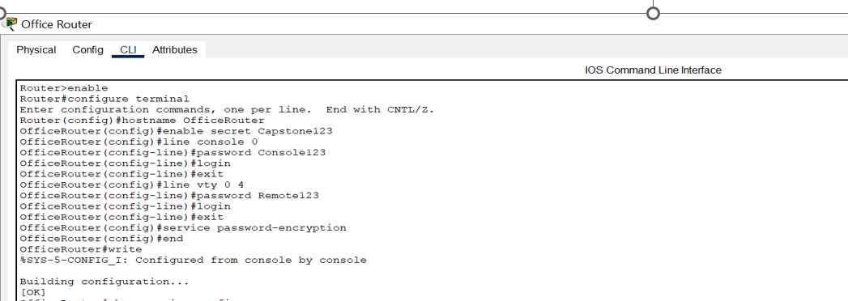
CAPSTONE PROJECT
Security Control 1: Password and Access Control
Configured an enable secret on the router.
Configured console password protection.
Configured VTY/remote access password protection.
Enabled password encryption using service password-encryption.
Saved the configuration with write.
Disclaimer: This training material belongs to techcrush and shouldn’t be shared

Slide 7
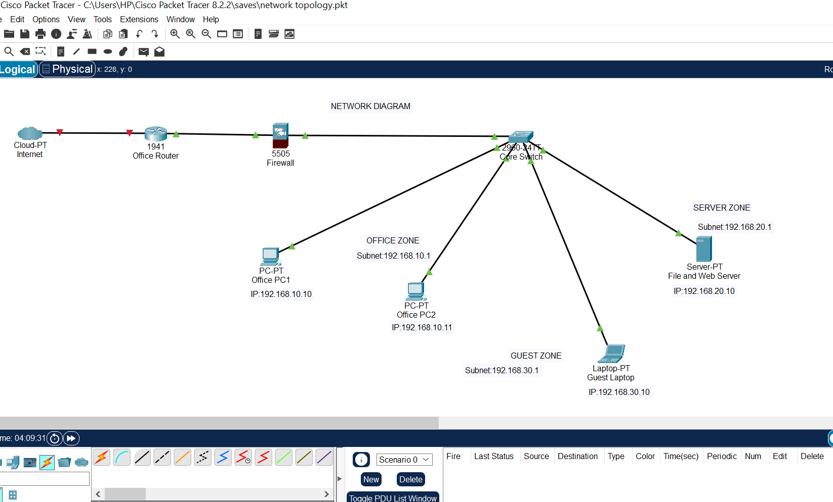
CAPSTONE PROJECT
Security Control 2: Network Segmentation
The network is divided into Office, Server, and Guest zones.
Each zone has a different IP subnet.
Same-zone communication is allowed.
Cross-zone communication is restricted unless routing or firewall rules allow it.
This limits unauthorized access and reduces lateral movement
Disclaimer: This training material belongs to techcrush and shouldn’t be shared

Slide 8
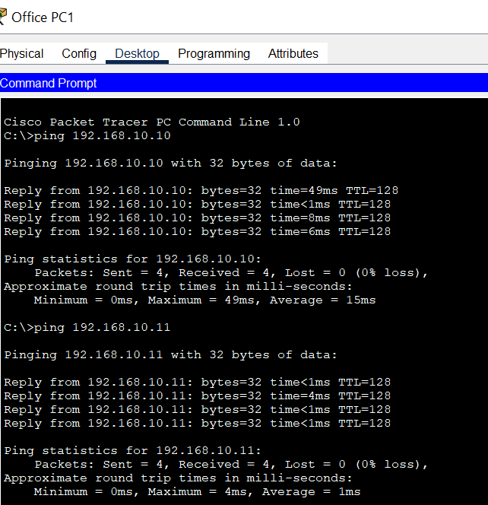
CAPSTONE PROJECT
Segmentation Test: Ping Results
Test | Result | Meaning
PC1 → PC2 (192.168.10.11) | Successful | Same Office Zone communication works
PC1 → Server (192.168.20.10) | Timed out | Server Zone is isolated without routing/rules
PC1 → Guest (192.168.30.10) | Timed out/blocked | Guest Zone is separated from Office Zone
Disclaimer: This training material belongs to techcrush and shouldn’t be shared

Slide 9
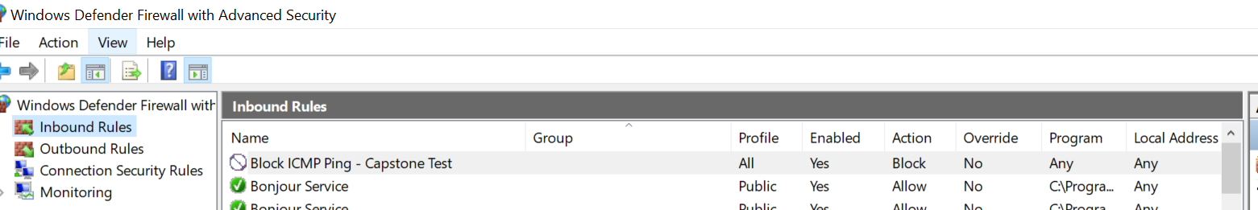
CAPSTONE PROJECT
Security Control 3: Windows Defender Firewall Rules
Control / Rule | Action | Implemented or Recommended | Reason
Block ICMPv4 Echo Request | Block | Implemented | Prevents the system from responding to ping/network discovery attempts
Allow required trusted traffic | Allow | Recommended | Allows normal approved business communication
Block unnecessary inbound traffic | Block | Recommended | Reduces exposure to unauthorized access attempts
Review open ports after Nmap scan | Monitor/Restrict | Implemented as scan/review | Helps identify services that should be disabled, restricted, or protected
Block insecure services such as Telnet/unused FTP | Block | Recommended | Reduces risk from insecure or unnecessary services
Windows Defender Firewall was used as the system firewall to demonstrate how to block or allow traffic. A custom inbound rule was created to block ICMPv4 echo requests, which are commonly used by ping. This shows how a firewall can reduce system visibility during basic network discovery. No specific TCP or UDP port was blocked. Nmap results identify open ports, and we recommend blocking or disabling unnecessary or insecure services.
Disclaimer: This training material belongs to techcrush and shouldn’t be shared

Slide 10
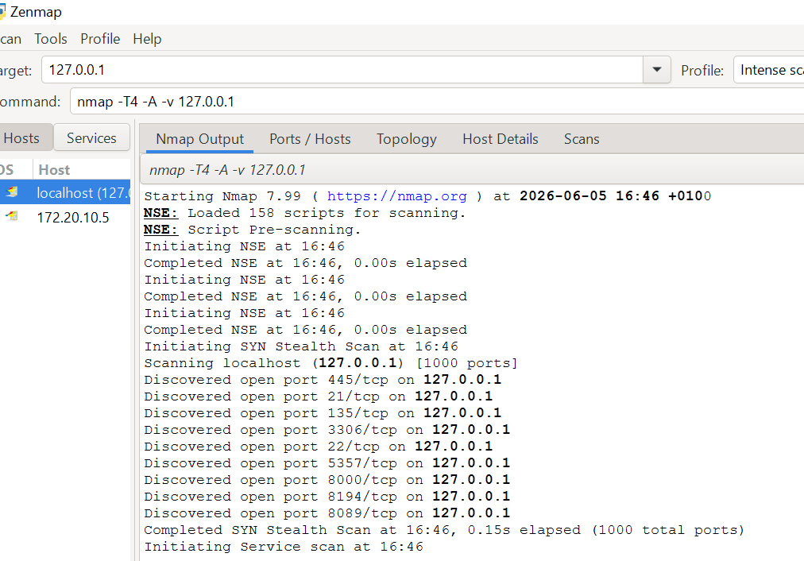
CAPSTONE PROJECT
Security Control 4: Port Scanning and Hardening
Nmap/Zenmap was used to simulate port scanning.
The Packet Tracer server was not directly reachable from the Windows host, so host scans were used to demonstrate the concept.
Open ports indicate exposed services that may become targets of attack.
Hardening means closing, disabling, or restricting unnecessary services.
Disclaimer: This training material belongs to techcrush and shouldn’t be shared

Slide 11
CAPSTONE PROJECT
Nmap Findings and Hardening Actions
Example Port | Service/Risk | Recommended Action
21/tcp | FTP; plaintext file transfer | Disable or replace with SFTP
22/tcp | SSH remote access | Allow only trusted admin access
23/tcp | Telnet; insecure remote login | Block/disable
80/443 | Web access | Allow only if required
3306/tcp | Database exposure | Restrict to server/admin network only
Security lesson: every unnecessary open port increases the attack surface
Disclaimer: This training material belongs to techcrush and shouldn’t be shared

Slide 12
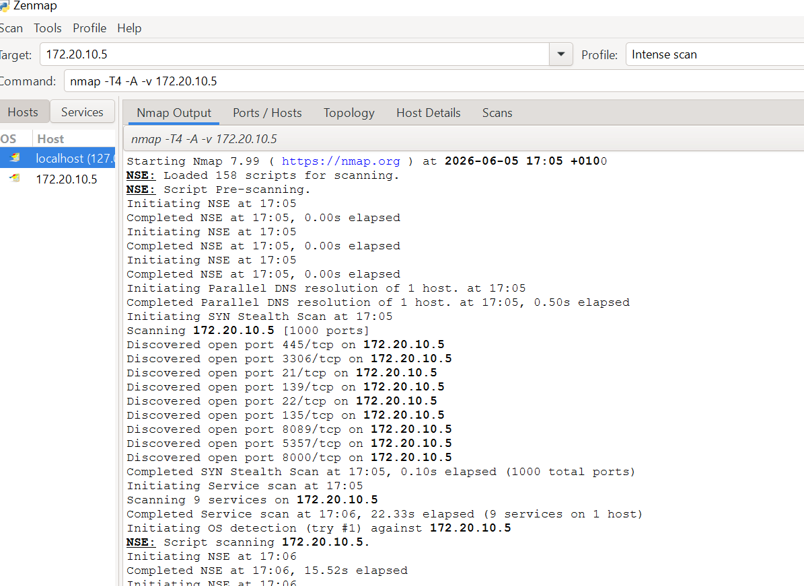
CAPSTONE PROJECT
Simulated Threat: Port Scanning Attack
Threat selected: port scanning attack.
An attacker scans a network to identify live hosts, open ports, and running services.
The attacker uses the information to find possible entry points.
Nmap/Zenmap was used to demonstrate how exposed services can be discovered.
Disclaimer: This training material belongs to techcrush and shouldn’t be shared

Slide 13
CAPSTONE PROJECT
Network Setup Checklist
Checklist Item | Status
Topology diagram includes router, firewall, switch, server, PCs, and guest device | Complete
Devices are grouped into Office, Server, and Guest zones | Complete
Router access passwords configured | Complete
Firewall/access rules documented | Complete
Nmap/Zenmap scan performed | Complete
Ping/connectivity testing performed | Complete
Screenshots collected for evidence | Complete
Disclaimer: This training material belongs to techcrush and shouldn’t be shared

Slide 14
CAPSTONE PROJECT
Challenges and Lessons Learned
Challenges
Packet Tracer devices are simulated and may not be directly reachable from the host machine using Nmap.
Different subnets require routing/firewall configuration before cross-zone traffic can pass.
Security controls should be planned before deployment, not added afterward.
Lessons learned
Segmentation reduces lateral movement.
Password protection secures network administration.
Firewall rules and hardening reduce the attack surface.
Monitoring tools help identify risks and traffic behavior.
Disclaimer: This training material belongs to techcrush and shouldn’t be shared

Slide 15
CAPSTONE PROJECT
Conclusion
This project demonstrated how to design and secure a small office network.
The topology included a router, firewall, core switch, office PCs, a server, and a guest laptop.
Security controls included password protection, segmentation, firewall rules, port scanning/hardening, and traffic analysis.
The simulated port scanning threat showed why access controls and hardening are important for real networks
Disclaimer: This training material belongs to techcrush and shouldn’t be shared

Slide 16
CAPSTONE PROJECT
References
Cisco Packet Tracer documentation
Nmap/Zenmap documentation
Wireshark User Guide
NIST Cybersecurity Framework
CISA guidance on network security and secure configuration
Disclaimer: This training material belongs to techcrush and shouldn’t be shared

Slide 17
CAPSTONE PROJECT
THANK YOU
Disclaimer: This training material belongs to techcrush and shouldn’t be shared

